Slide 1


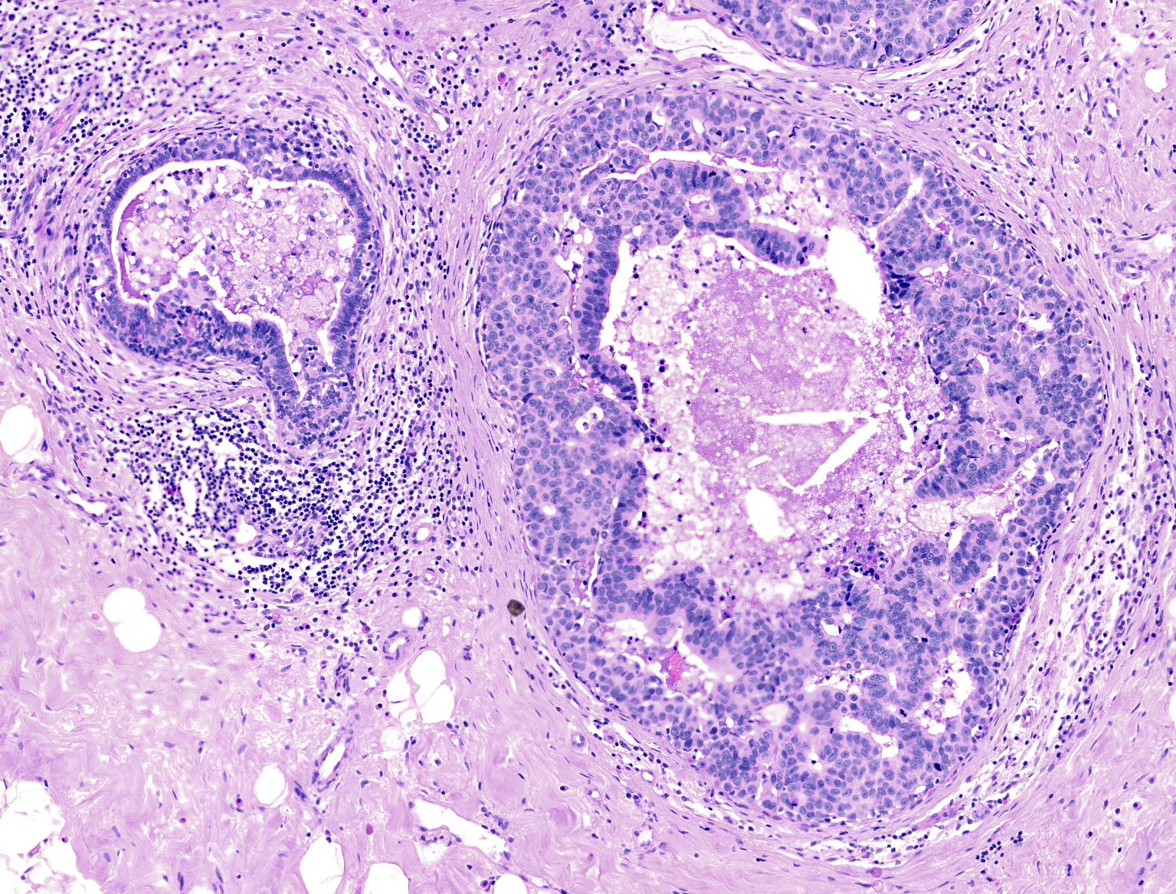
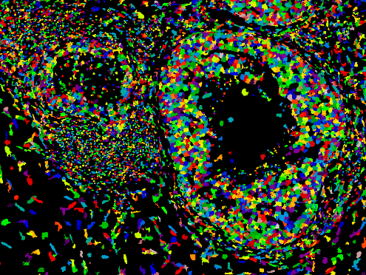
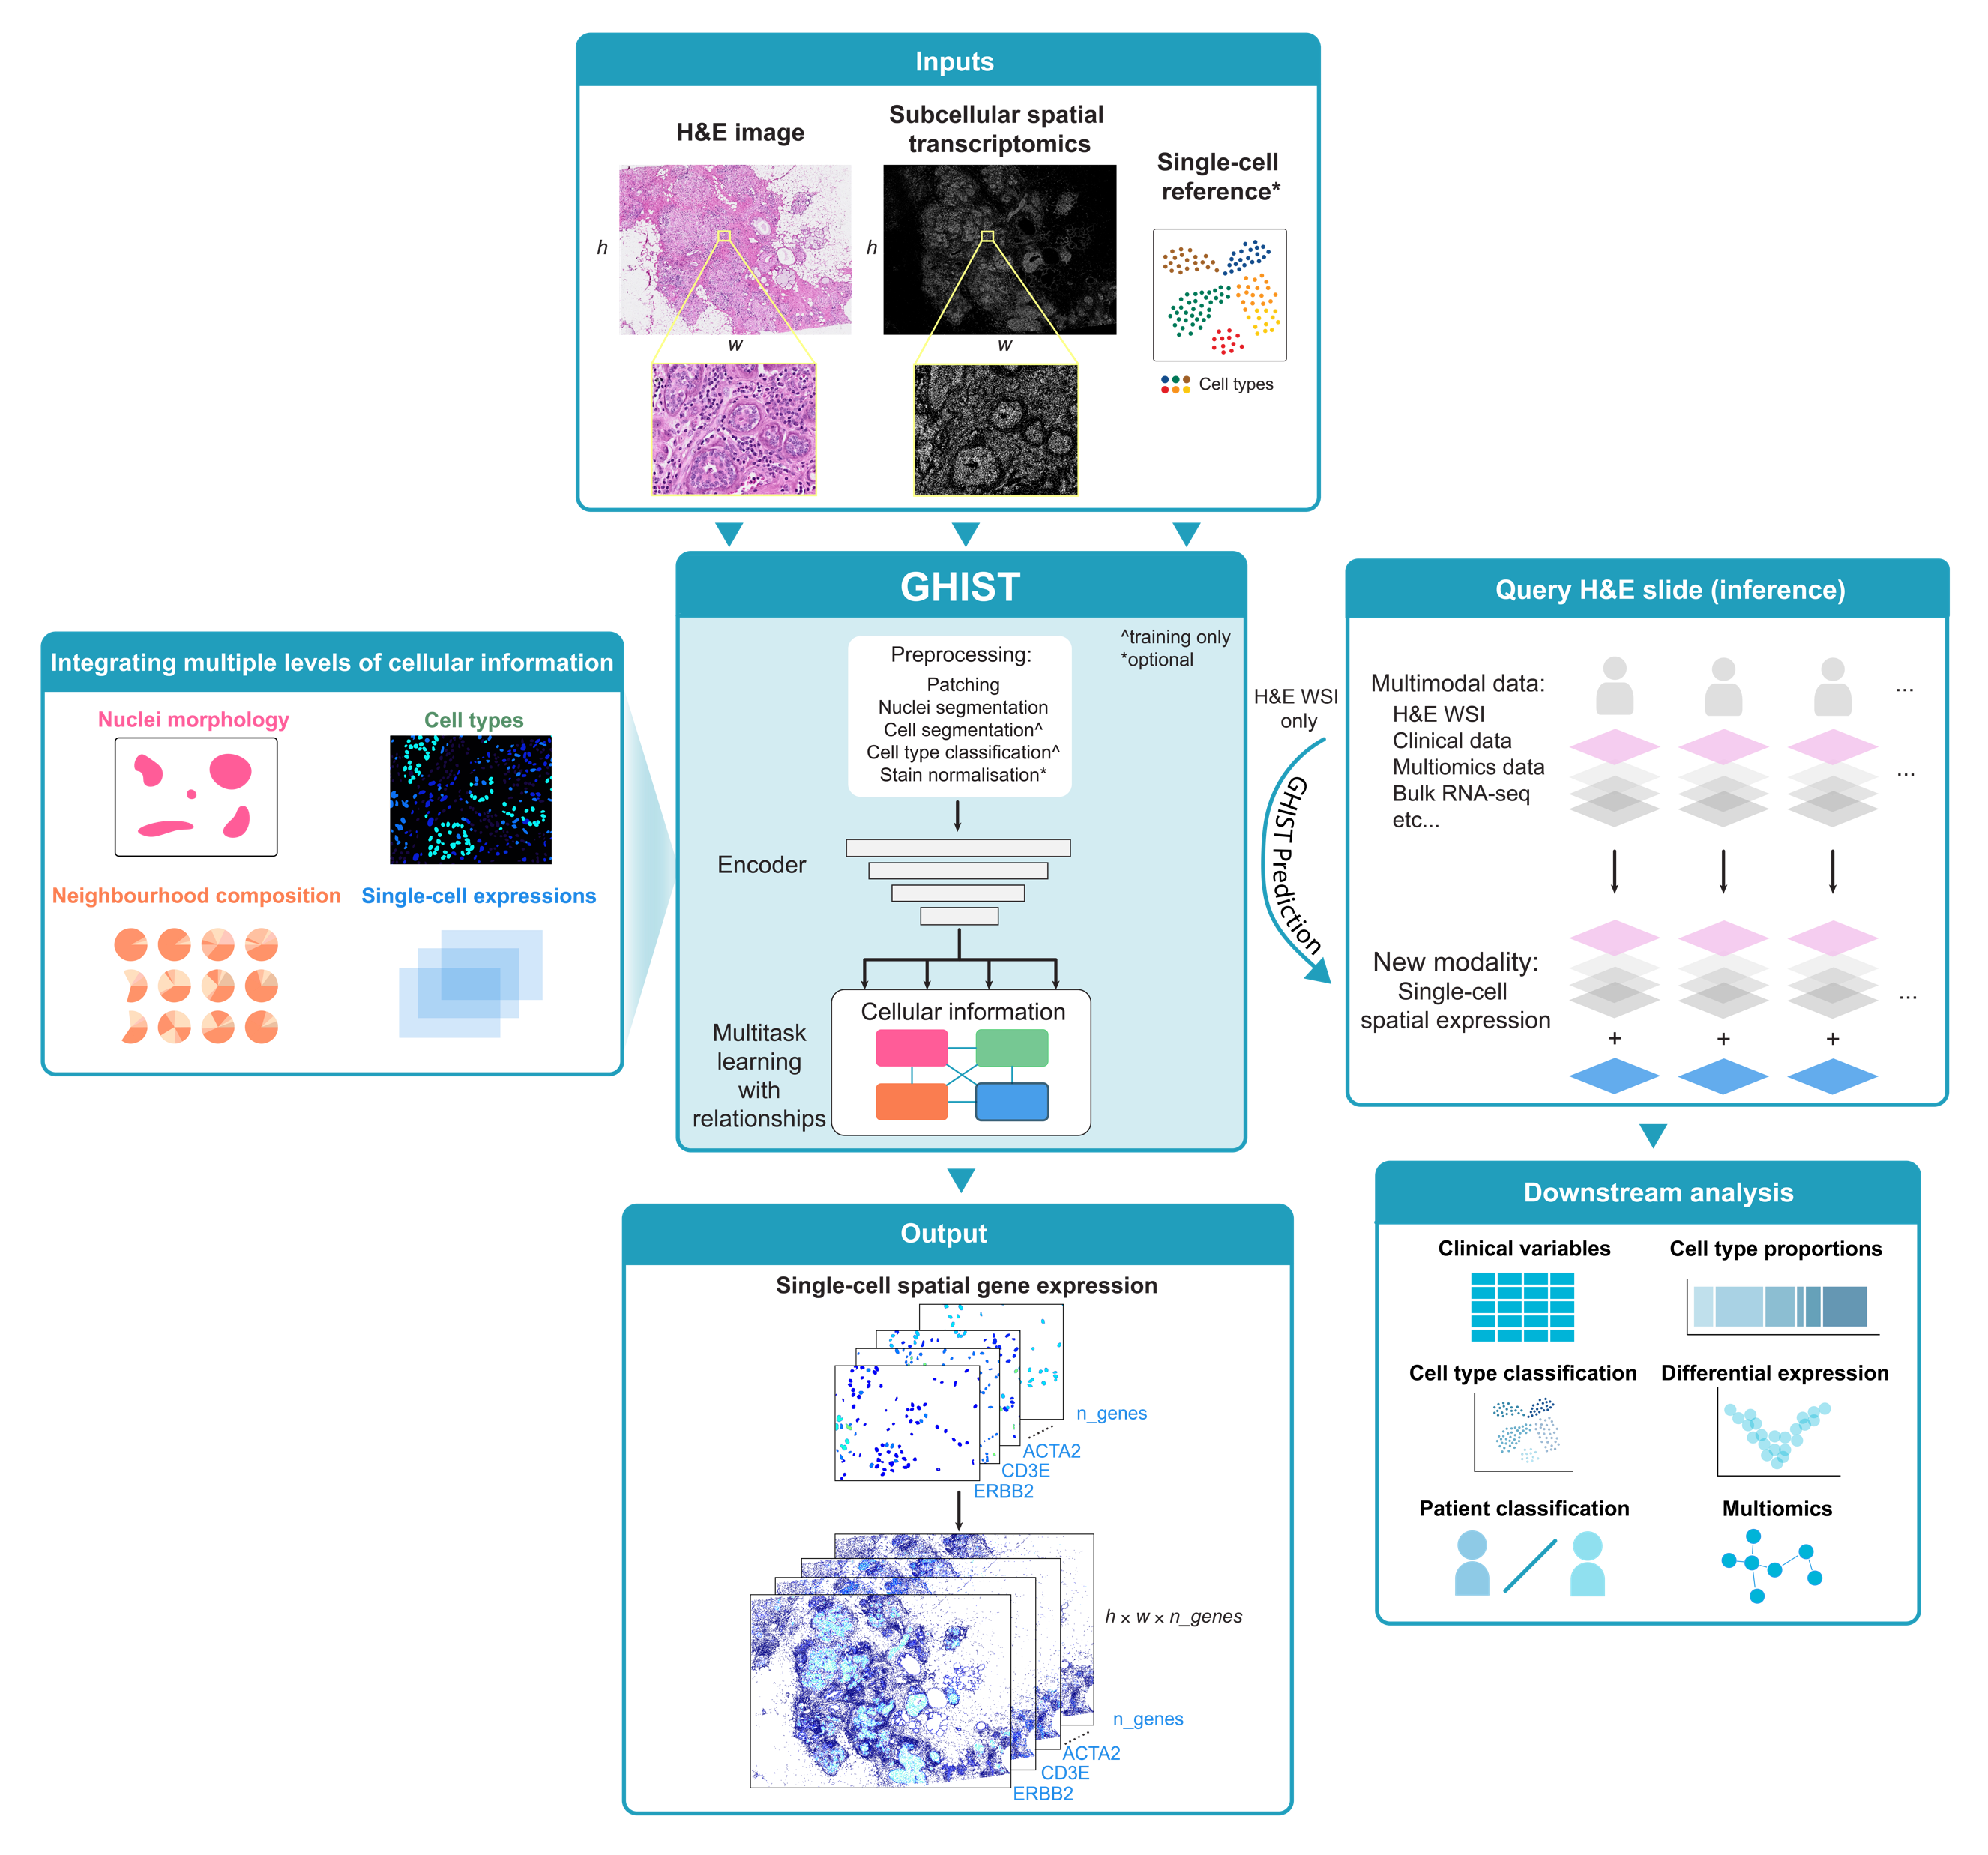
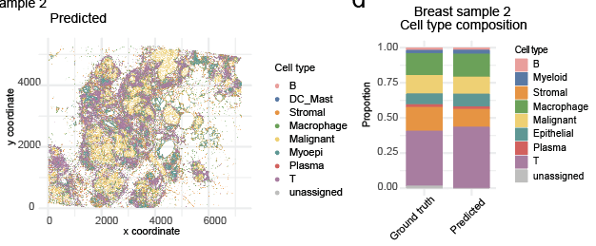
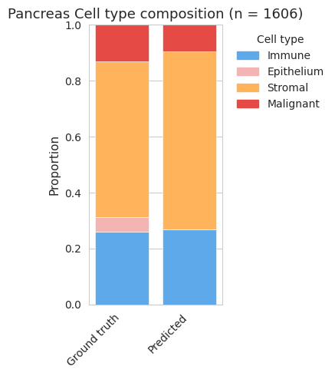
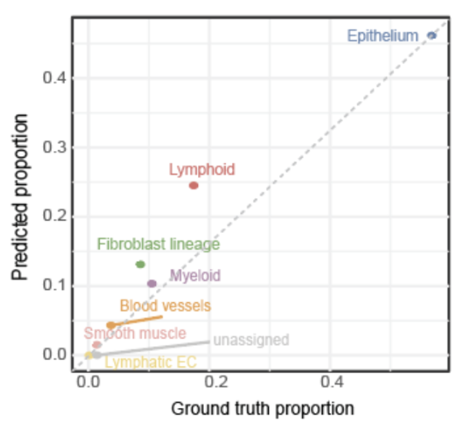
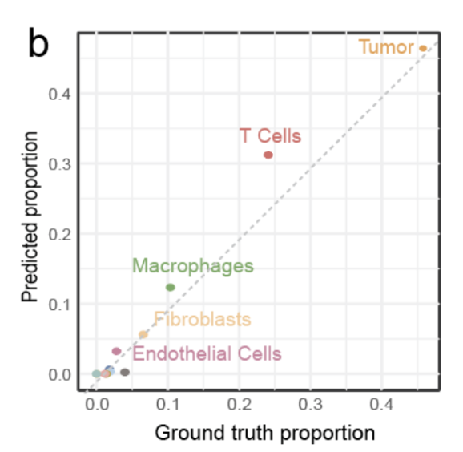

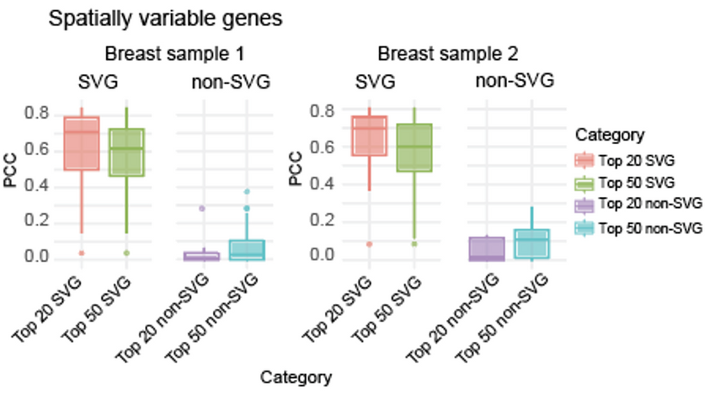
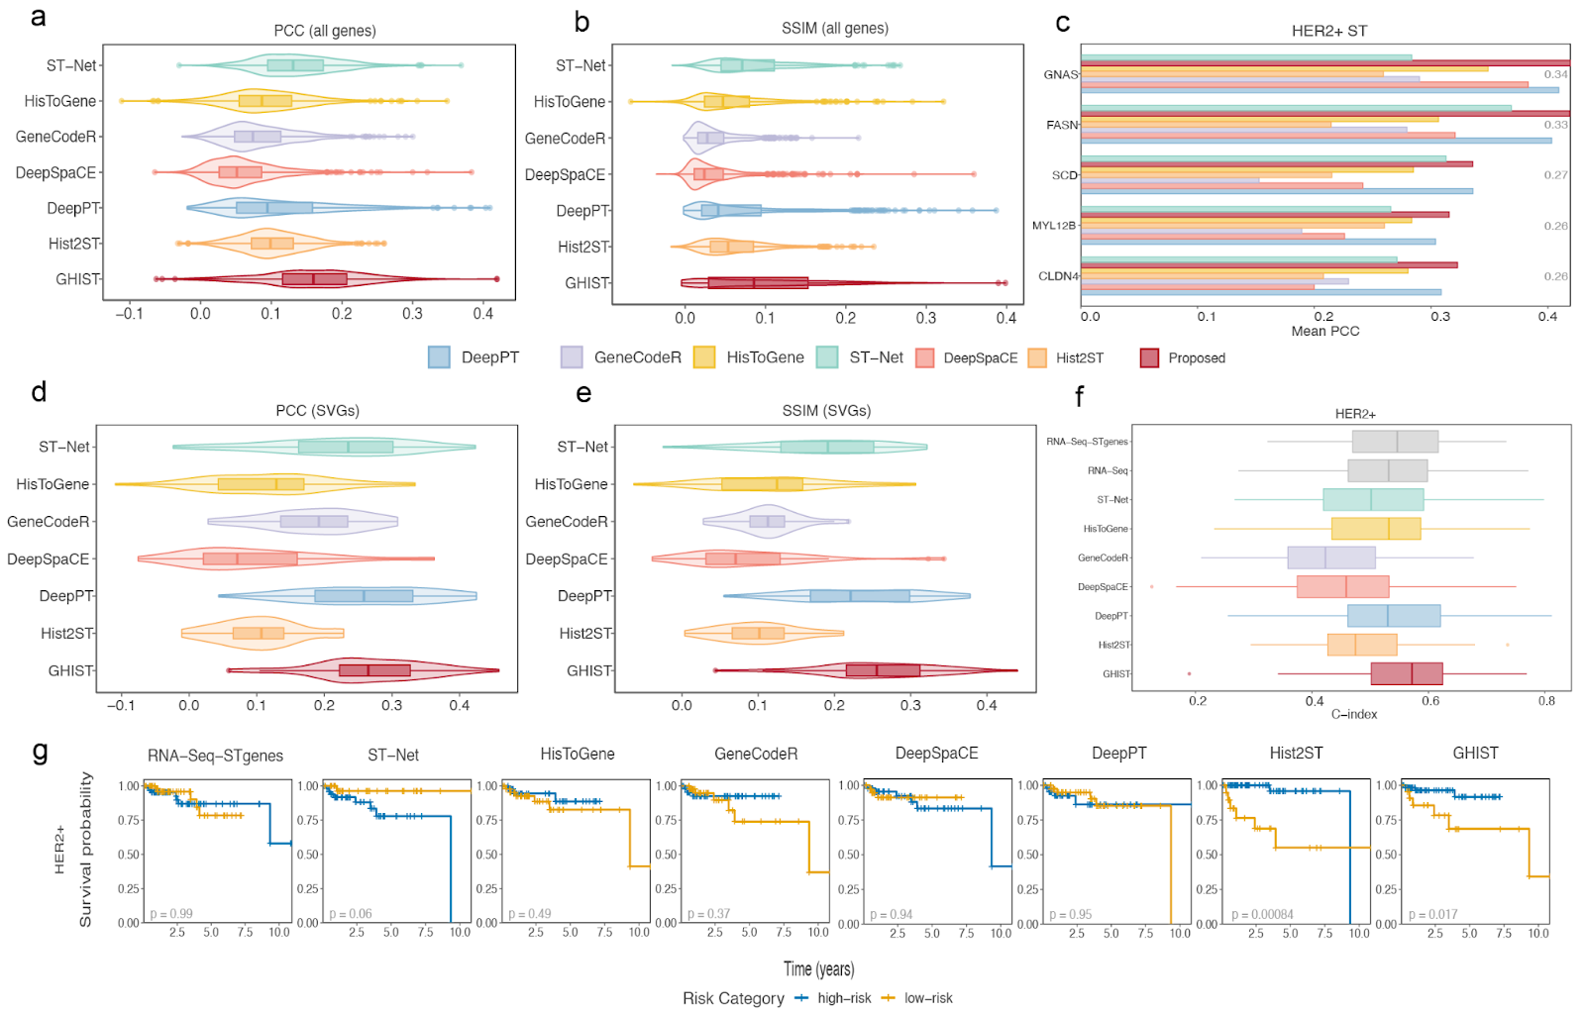
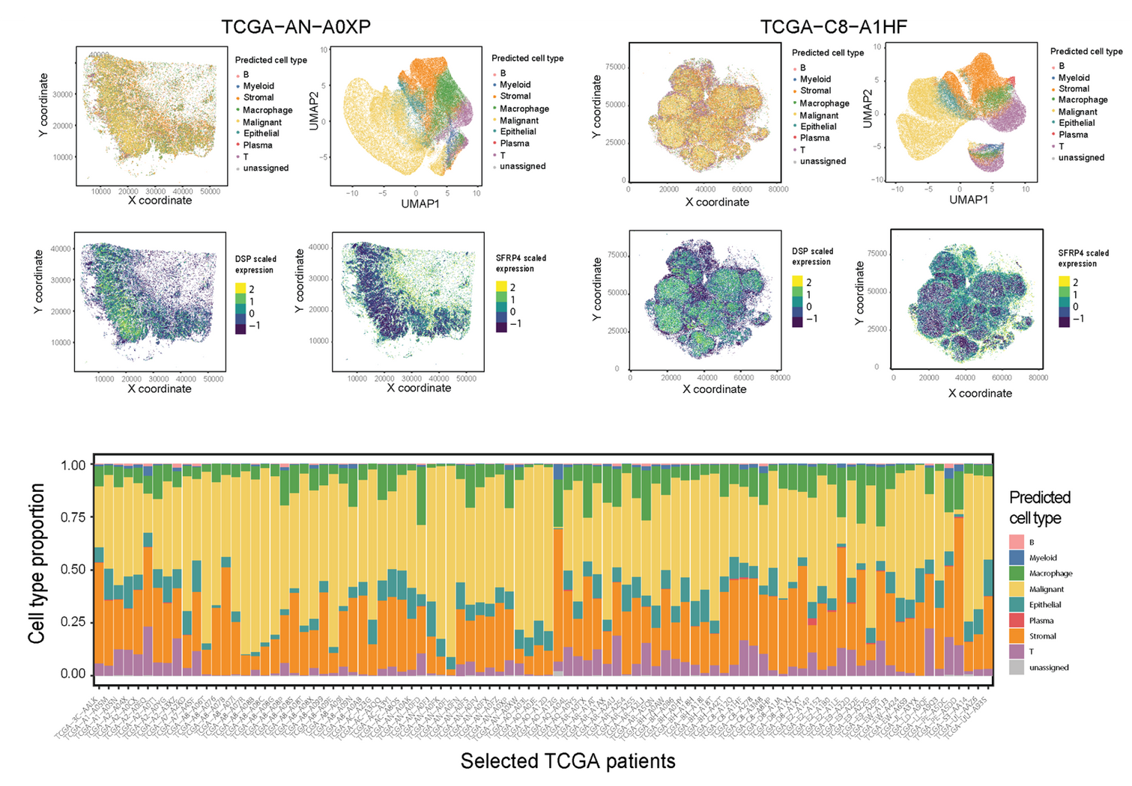
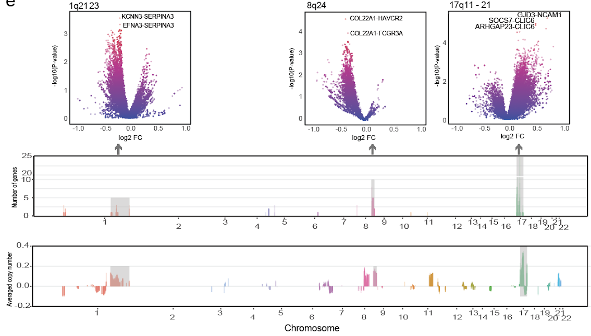

Spatial gene expression at single-cell resolution from histology using deep learning with GHIST
Zhang^{1,2} , X. Fu^{1,2,3,4,5^}, Y. Cao^{1,3,4,5^}, B. Bian^{1,3,4}, C. Wang^{2,3,5}, D. Graham^{6,7,8}, N. Pathmanathan^{7,8,9},
E. Patrick^{1,3,4,5,6}, J. Kim^{1,2,5}, J.Yang^{1,3,4,5}
¹ Sydney Precision Data Science Centre, University of Sydney ² School of Computer Science, The University of Sydney. ³ School of Mathematics and Statistics, The University of Sydney ⁴ Charles Perkins Centre, The University of Sydney
⁵ Laboratory of Data Discovery for Health Limited (D²4H), Science Park, Hong Kong
⁶ Centre for Cancer Research, The Westmead Institute for Medical Research ⁷ Westmead Breast Cancer Institute, Westmead Hospital, Western Sydney Local Health District
⁸ Faculty of Medicine and Health, University of Sydny
⁹ Douglass Hanly Moir Pathology, Macquarie Park, Australia
H&E images to spatially resolved transcriptomics (SRT)
Challenges
Motivations
SRT holds the potential to improve understanding and predictions of clinical outcomes for complex diseases like cancer
High cost of SRT technologies may limit their broad adoption
H&E-stained images are commonly available and could be leveraged to predict SRT to overcome this barrier
Previous methods focused on predicting lower resolution spot-based SRT
Spatially resolved single-cell Gene expression from HISTology (GHIST)
GHIST maps H&E images to the expression of hundreds of genes within individual cells in the image and provides spatial localisation of cells.
Challenges of H&E to single-cell prediction:
High number of unique gene expression profiles within one image
Discerning finer-grained variations in H&E images that correspond to subtle variations in gene expression
Cell types with similar morphologies/visual appearance have distinct gene expression profiles (e.g., B and T cells)
Influence on gene expression from neighbouring cells
H&E to spot-based SRT
Genes
H&E-stained image
Spots
Prediction per patch
n_spots × n_genes
H&E to single-cell SRT
Genes
Multi-level Evaluation 1 - Single-cell level
Cells
GHIST effectively captures gene expression at single-cell resolution
Data: using 4 different cancer data from Xenium
Ground truth cell-types define by segmenting cells from SST data follow by cell-type annotation tool (scClassify) Evaluation metrics: a. Compared cell type distribution between predicted and ground truth cell types.
b. Correlation of predicted and ground truth gene expression among SGG.
Prediction per cell
n_cells × n_genes
GHIST using single cell SRT for training
Model:
GHIST synergistically captures interdependencies between information on cell type, neighbourhood composition, nuclei morphology, and single-cell expressions to improve prediction performance
GHIST consists of a multitask architecture and multiple loss functions
Training:
GHIST learns from paired H&E and subcellular SRT data (e.g, Xenium) that has been segmented to provide single-cell data
Inference:
Once trained, GHIST predicts SRT from H&E images alone
Predicted
Breast cancer 2
Pancreas
Lung
Adenocarcinoma
Melanoma
Both compositional barplots and scatter plots shows that spatial mapping of cell types and predicted proportion shows alignment with ground truth for 4 different cancers.
Predicted
Predicted
Ground truth
Ground truth
High correlation with HVG or SVG genes and zero or low correlation with non-SVGs (as expected)
Aim to see large differences between the two sets of boxplots
Multi-level Evaluation 2 – Spot level
Multi-level Evaluation 3 – External data - TCGA
Comparison of spot-based gene prediction and survival analysis performance among state-of-the-art methods using the HER2ST dataset
Details on methods could be found in our Benchmarking work (Wang et al 2025)
Application of GHIST to TCGA breast cancer H&E images
Data: we examine 92 HER2+ samples
This demonstrate potential of GHIST to create an in silico modality for downstream analysis
Malignant cell type marker EPCAM and a stromal cell type marker SFRP4 are used to visualise the GHIST predicted location of the two cell types (middle)
Enables the predicted cell type proportions for the selected TCGA HER2+ patients (bottom)
Potential of GHIST to create an in silico modality for multi-view analysis
Differential spatial gene expression affected by copy number alteration
Volcano plots display 3 selected hotspots (1, 8, 17q) that affect a number of spatial expression patterns of genes (top)
The number of differential patterning genes that were affected by each CNA (middle)
Averaged copy number alteration profiles of 2,177 genes tested in the 91 patients are displayed (bottom)
Data: HER2ST data (Anderson et al, 2021)
GHIST is extendable to spot-based technologies and outperforms state-of-the-art methods
Evaluate the spot-based SGE predictions with Pearson Correlation Coefficient (PCC) focusing on top 20% SVG genes
Evaluate translational potential of predicted SGE
Data: 92 HER2+ TCGA-BRCA individuals
Strategy: Convert the predicted SGE to pseudobulk GE for each patient and built multivariate Cox regression models from the pseudobulk GE to predict survival using a 3-fold CV with 100 repeats
Scan for more tools SCDNEY
References:
Wang, C. et al. Benchmarking the translational potential of spatial gene expression prediction from histology. Nat Commun 16, 1544 (2025)
Andersson, A. et al. Spatial deconvolution of HER2-positive breast cancer delineates tumor-associated cell type interactions. Nat. Commun. 12, 1–14 (2021)
NEXT STEP: GHIST’s cross-tumour benchmarking along with pan-cancer single-cell atlases reveal shared microenvironments across many tumours demonstrates the feasibility of creating a pan-cancer model across cancers without retraining.

